Slide 1

INTELLIGENZA ARTIFICIALE
E NUTRIZIONE
Prof. Luigi SCHIAVO, PhD, FACN
Professore Associato di Scienza dell’Alimentazione e delle Tecniche Dietetiche Applicate
Dipartimento di Medicina, Chirurgia e Odontoiatria
Università degli Studi di Salerno
DELEGATO AREA NUTRIZIONALE E SOCI AFFINI SICOB (Campania)

Slide 2

Artificial intelligence: definition and primary scope
The simulation of Human Intelligence by software-coded heuristics
[mental shortcuts, which allow you to build a generic idea on a topic without making too much cognitive effort]

Slide 3
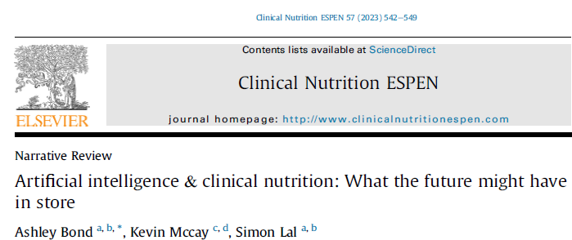
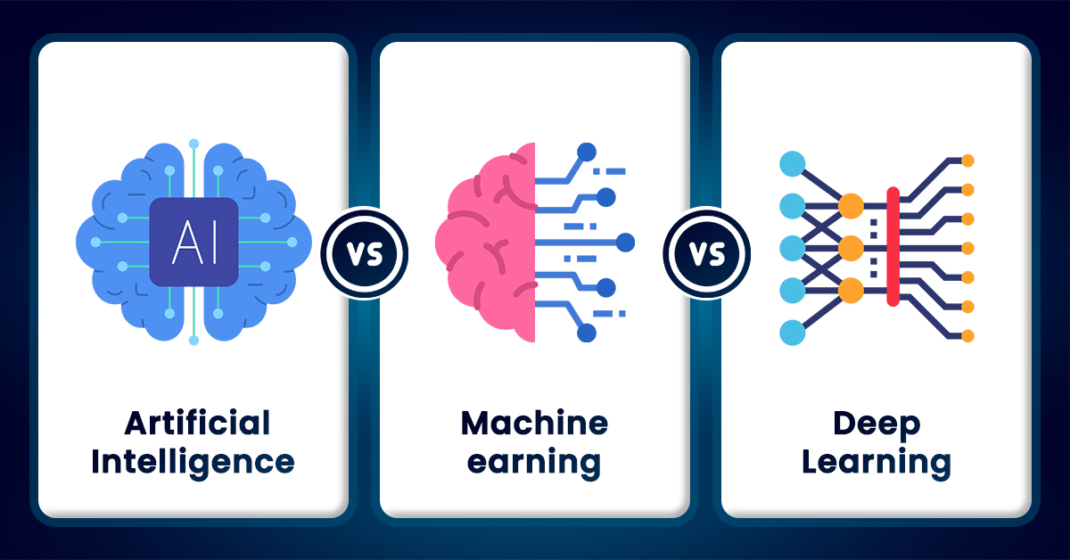
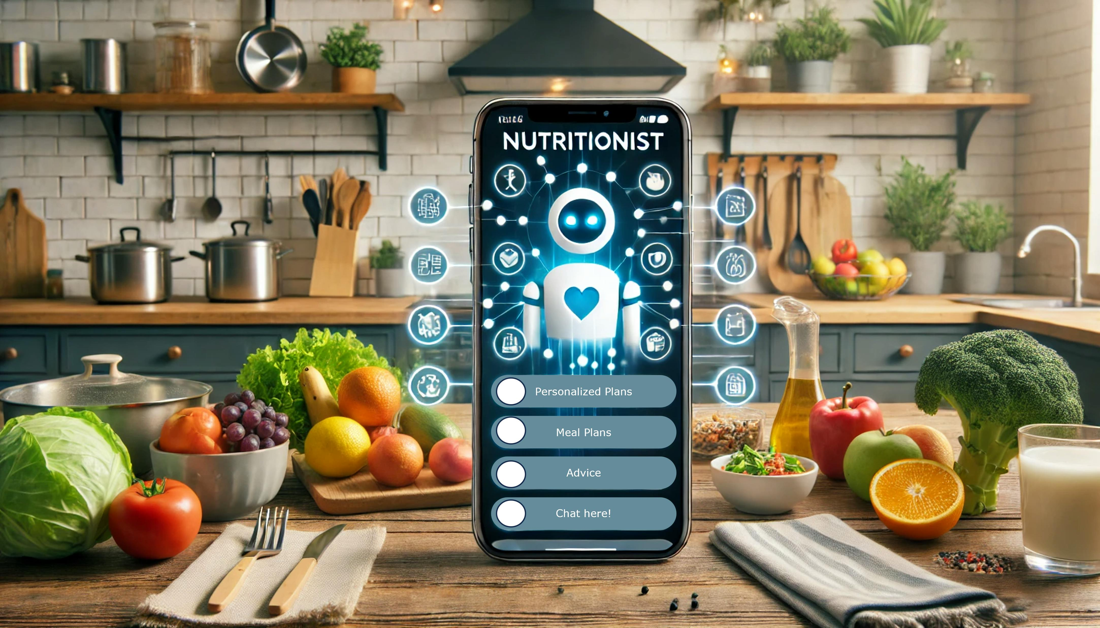
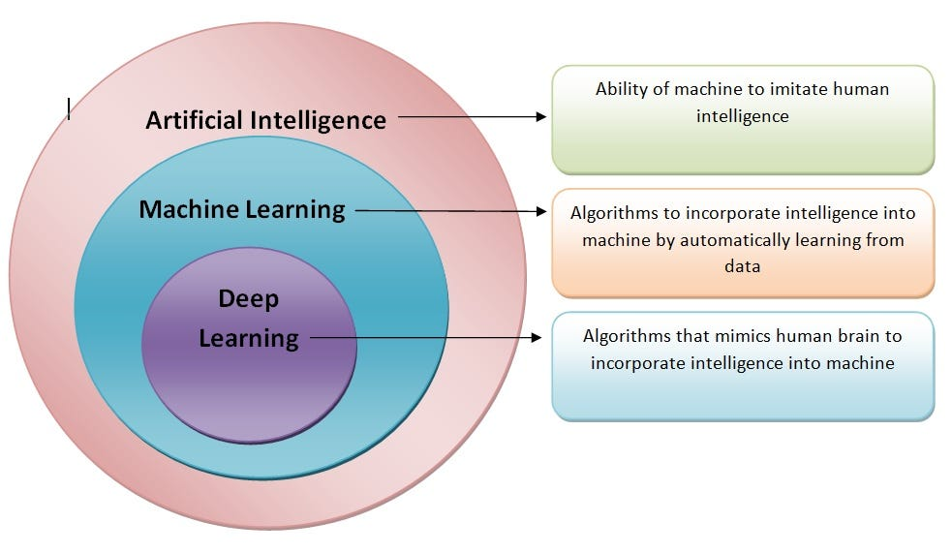

Slide 4
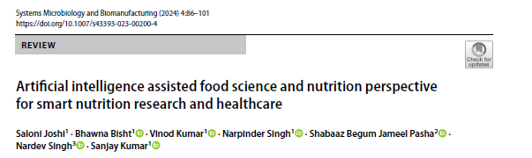
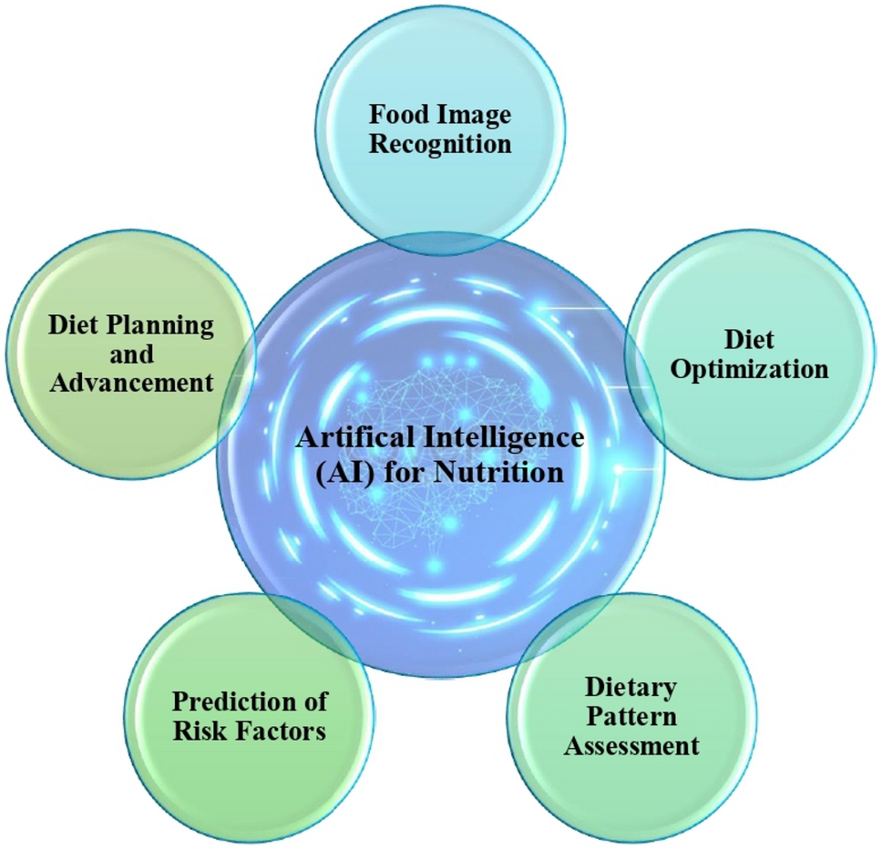
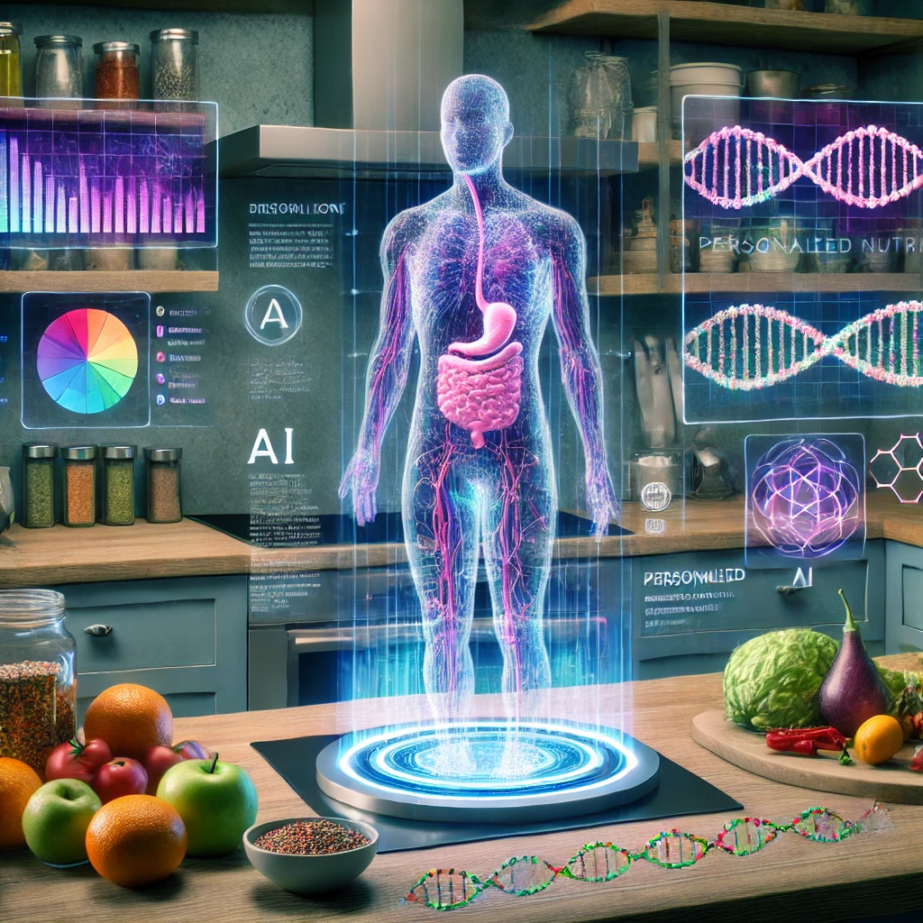
Application of Artificial Intelligence in Nutrition
Dietary assessment
Personalized Nutrition and Diet Planning
Nutrition Practice and Research

Slide 5
Application of Artificial Intelligence in Nutrition
Dietary assessment
Personalized Nutrition and Diet Planning
Nutrition Practice and Research

Slide 6
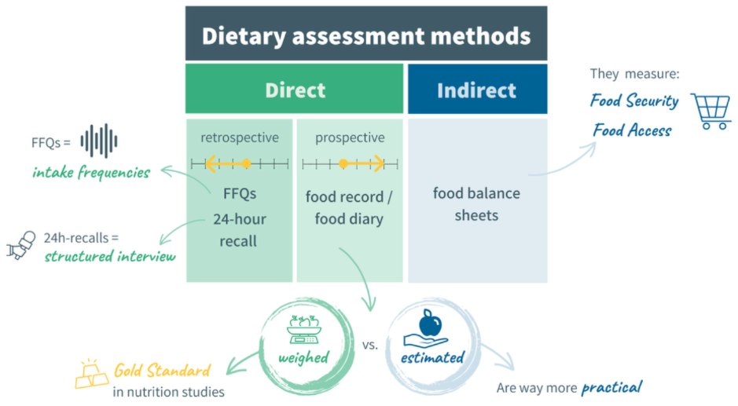
Dietary assessment is one of the most important steps in the nutrition care plan
The most common methods used in nutrition research are:
the diet record
24hr-recall (most accurate)
FFQs
Each method has benefits and drawbacks: First, are mostly dependent on memory.
The use of AI in dietary assessment may reduce this bias

Slide 7
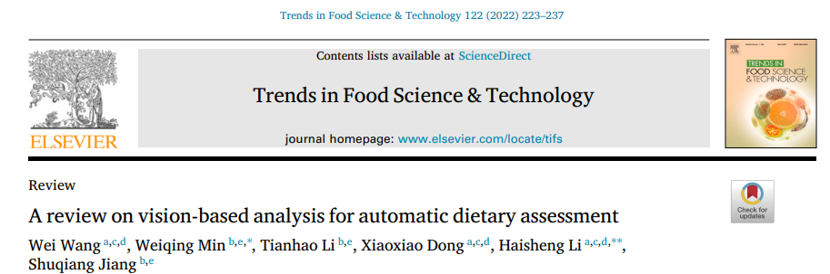
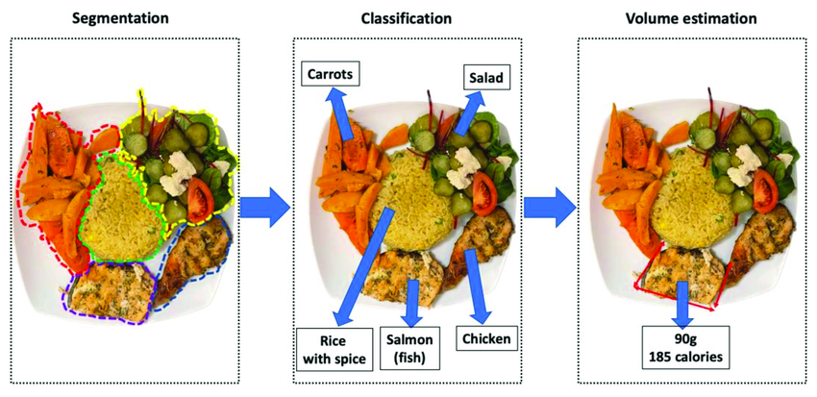
Volume and
Calorific estimation
Vision-based AI dietary
assessment methods
Food recognition applications aim to identify and recognize food on a given dish with precision.
After food recognition itself, the next challenge for automatic food analysis is to estimate the volume and the calorific estimation of food on a given plate.
The schematic workflow shows the steps for image-based dietary assessment

Slide 8
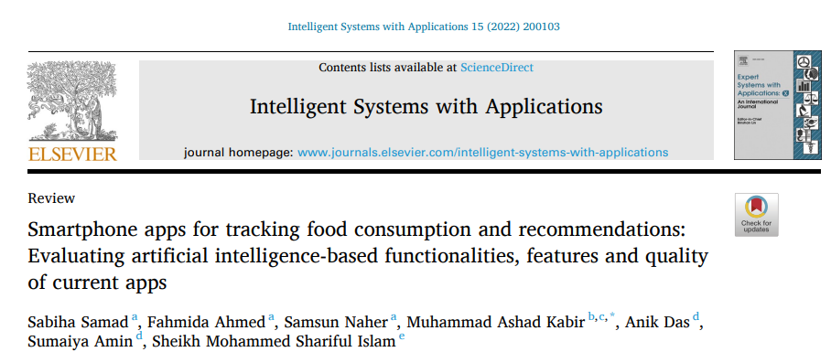
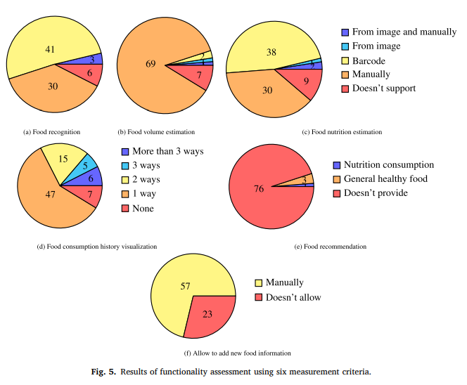
A critical review evaluated 80 main food tracking applications and found that 3 of 80 apps (Foodzilla, Bitesnap, and Food visor) were able to recognize the food intake automatically and manually.

Slide 9
Application of Artificial Intelligence in Nutrition
Dietary assessment
Personalized Nutrition and Diet Planning
Nutrition Practice and Research

Slide 10
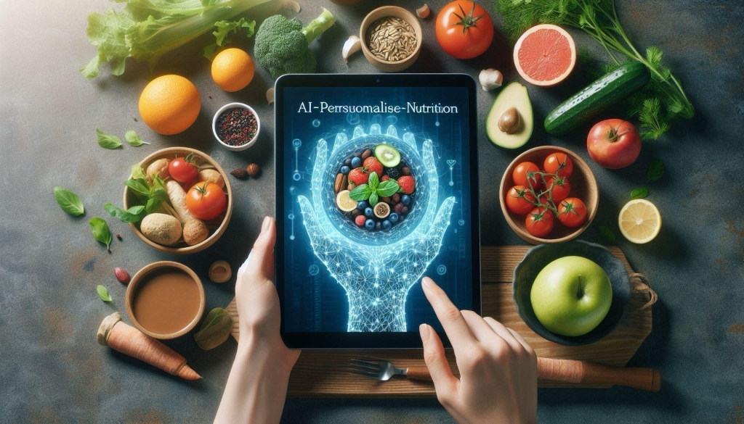

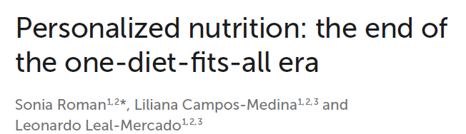
2022, 11:1370595
Personalized nutrition is an approach that tailors' nutrition advice to individuals based on:
individual's needs
preferences
individual lifestyle
socioeconomic status
race or ethnicity
health history
gender
genetic information

Slide 11
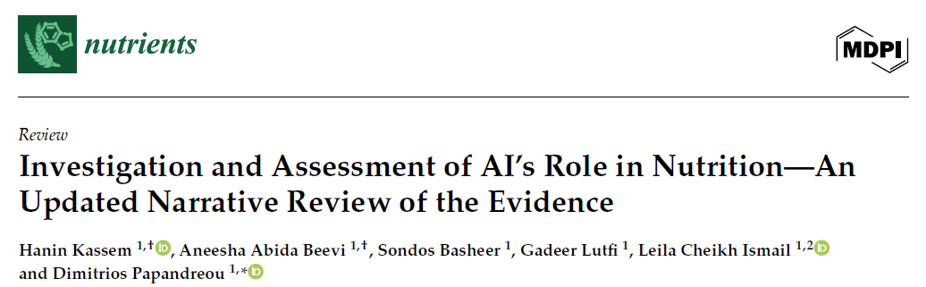
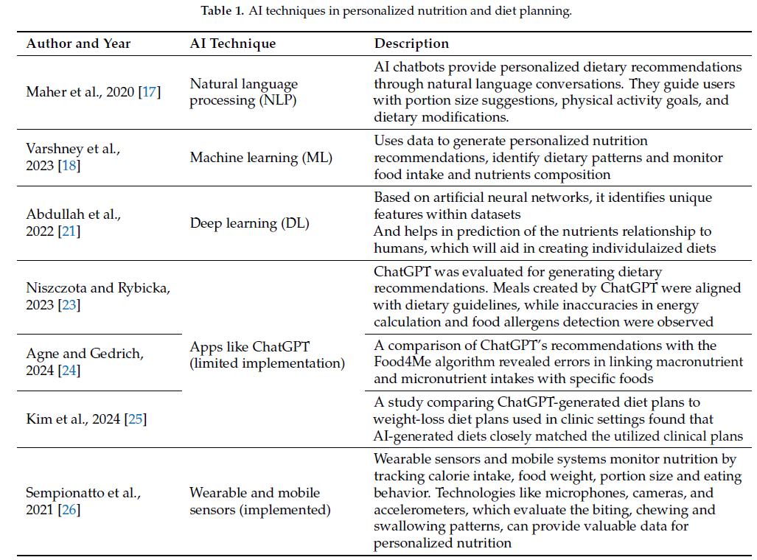
2025, 17, 190

Slide 12

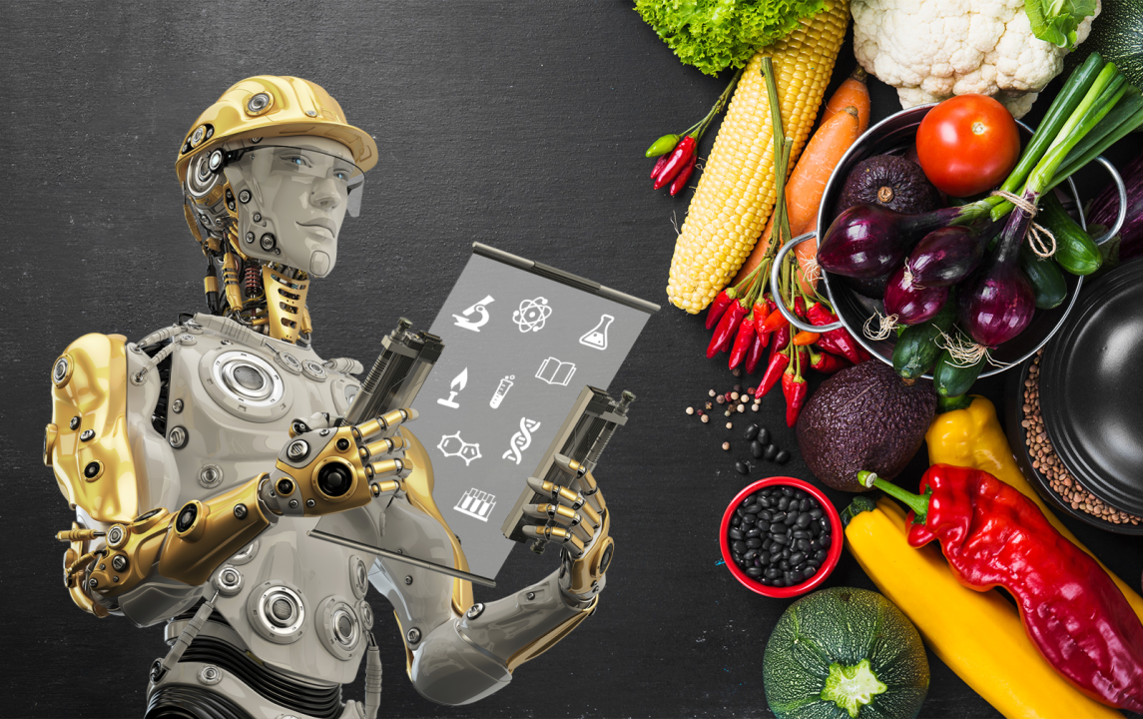
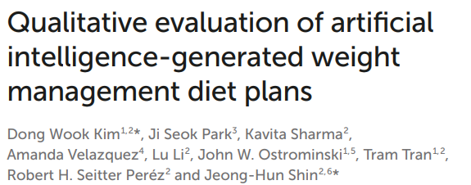
2024, 11:1374834
Design, setting, and participants: ChatGPT (4.0) was used to create weight loss diet plans and selected two control diet plans for comparison.
Main outcomes and measures: The primary outcomes measured included the indistinguishability of the AI diet plan from human-created plans, and the potential of personalized AI-generated diet plans for real-world clinical applications.
Objective: To evaluate the potential of personalized AI generated weight-loss diet plans for clinical applications by employing a survey-based assessment conducted by experts in the fields of obesity medicine and clinical nutrition.

Slide 13
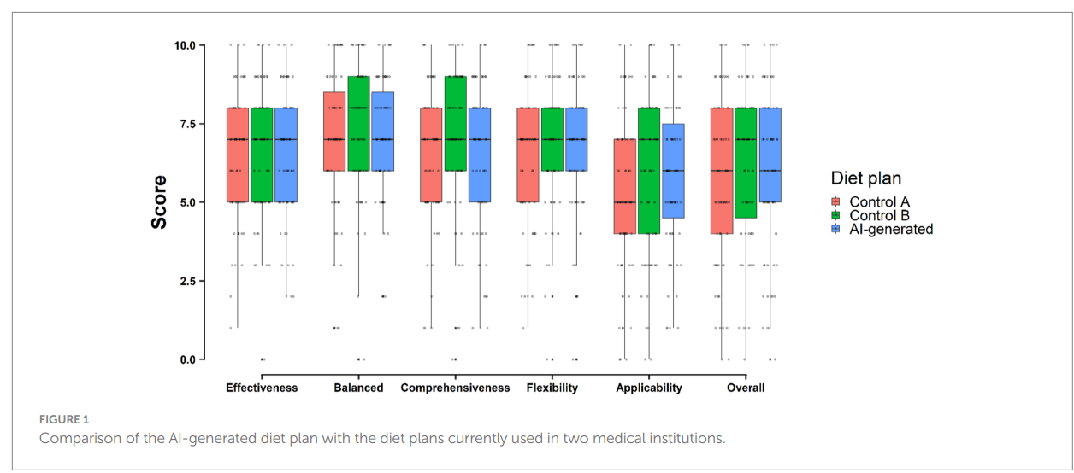
The 67 respondents who completed the weight loss diet plan comparison did not show significant differences across the three diet plans in any evaluation category, including in the overall evaluation score.
Of the 67 experts, 53 (79.1%) reported being unable to distinguish which diet plan was AI-generated.

Slide 14
Application of Artificial Intelligence in Nutrition
Dietary assessment
Personalized Nutrition and Diet Planning
Nutrition Practice and Research

Slide 15
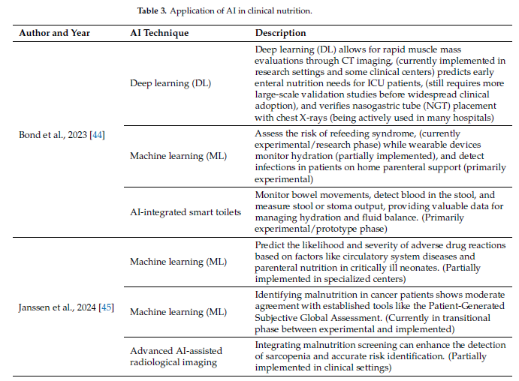

Application of AI in Clinical Nutrition

Slide 16
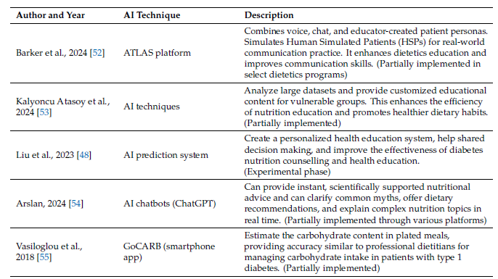
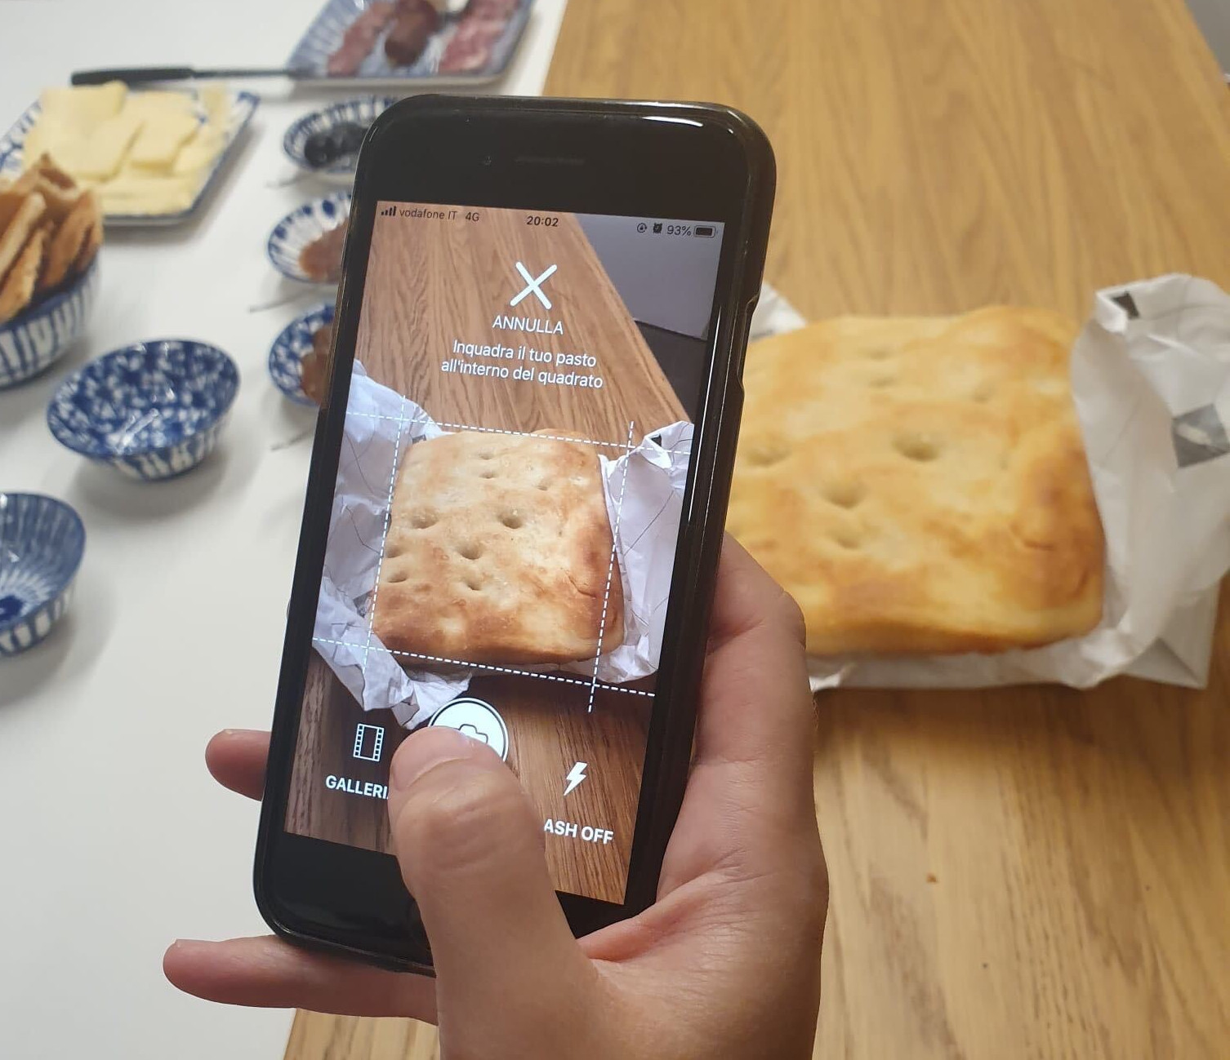
Application of AI in Clinical Nutrition

Slide 17
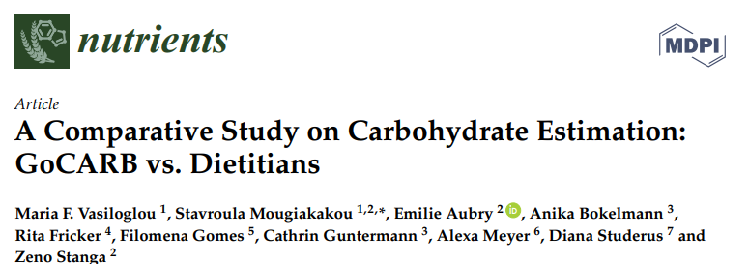
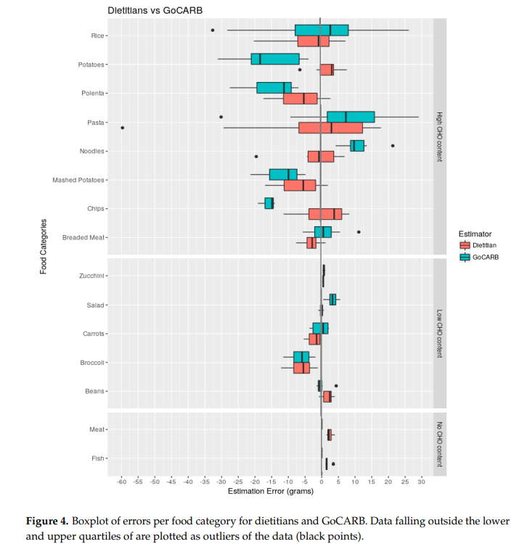
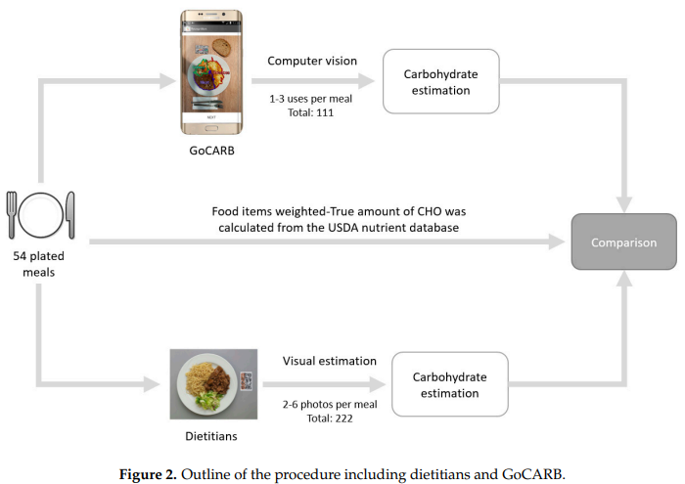
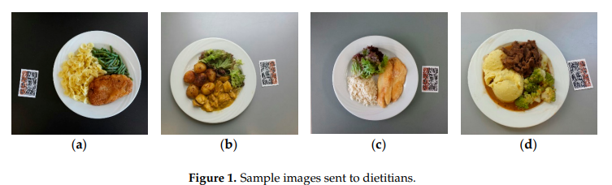
GoCARB is a computer vision-based smartphone system designed for individuals with Type 1 Diabetes to estimate plated meals’ carbohydrate (CHO) content
The study aimed to compare the accuracy of GoCARB in estimating CHO with the estimations of six experienced dietitians
GoCARB and dietitians achieved
comparable accuracies

Slide 18
The mean absolute error of the dietitians was 14.9 (SD 10.12) g of CHO versus 14.8 (SD 9.73) g of CHO for the GoCARB (p = 0.93).
No differences were found between the estimations of dietitians and GoCARB, regardless the meal size.
GoCARB had difficulty in estimating rice, pasta, potatoes, and mashed potatoes, while dietitians had problems with pasta, chips, rice, and polenta
GoCARB may offer diabetic patients the option of an easy, accurate, and almost real-time estimation of the CHO content of plated meals and thus enhance diabetes self-management.

Slide 19


Advantages of AI in Nutrition
Enhanced Dietary Assessment: Improved accuracy through AI-powered image recognition.
Personalized Nutrition: Tailored recommendations using genetics and real-time biomarkers.
Real-Time Monitoring: Wearables enable dynamic tracking and dietary adjustments.
Disadvantages of AI in Nutrition
Overreliance on Technology: May diminish clinician involvement and judgment.
Limited Validation: Many tools lack robust clinical testing.
Inaccuracy in Complex Cases: Patients with several comorbidities.

Slide 20


Limitation of AI in Nutrition
Data Privacy and Ethical Risks: Unauthorized access, misuse, and anonymization failures.
Bias and Data Quality: Non-representative training data may worsen health disparities.
Model Reliability and Accuracy: Dependence on self-reported data introduces inaccuracies.
Lack of Transparency: 'Black box' algorithms undermine clinical trust.
Scalability and Cultural Adaptability: Limited applicability across diverse populations.
Future Perspectives of AI in Nutrition
Precision Nutrition Evolution: Integration of -omics data for personalized diets.
Ethical and Regulatory Frameworks: Need for transparent, equitable governance.
Interdisciplinary Collaboration: Involving clinicians, tech developers, and policymakers.
Culturally Inclusive Databases: Improve global relevance and accuracy.
Intelligent Feedback Systems: Real-time, adaptive AI to improve long-term outcomes.

Slide 21


